Slide 1
Data Literacy and Management Basics
DS 100 – Module 1

Slide 2
https://github.com/pcmathias/MSACL-data-literacy

Slide 3
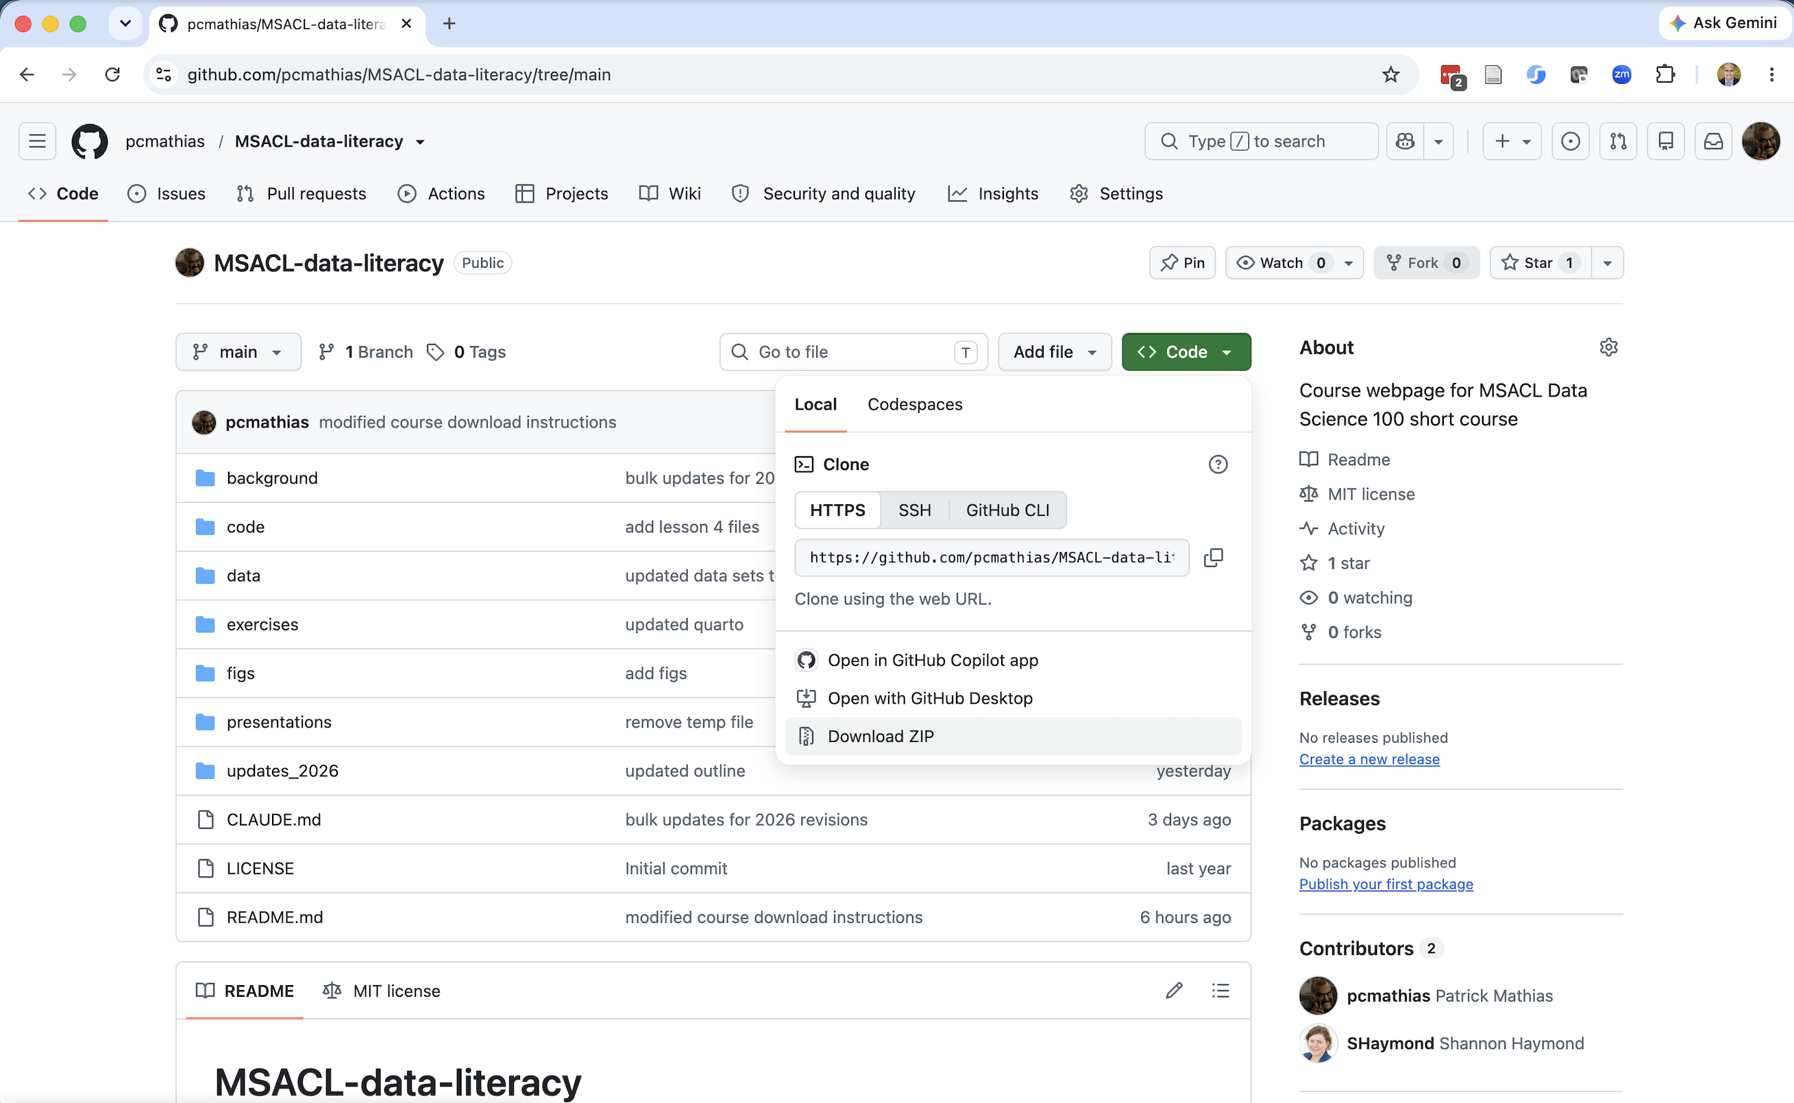
1. Click green “Code” button
2. Click “Download ZIP”
3. Save file to visible place (e.g. a Projects folder)
4. Unzip

Slide 4
Disclosure of Relevant Financial Relationships
The faculty, committee members, and staff who are in position to control the content of this activity are required to disclose to MSACL and to learners any financial relationships that have occurred within the last 24 months with ineligible companies whose primary business is producing, marketing, selling, re-selling, or distributing healthcare products used by or on patients. MSACL has reviewed the disclosures and mitigated all relevant financial relationships.
You can view the financial disclosures of any Steering / Scientific Committee Member or Podium Presenters (except for Industry Workshops, which do not qualify for CME credit) on the MSACL website directly underneath the person’s name. Click “Review Relevant Financial Disclosures”.
MSACL staff associated with the development of content for this activity report no relevant financial relationships.
Notes:
This slide must be included in your deck WITHOUT MODIFICATION. You will declare your Relevant Financial Relationships on the following slide.

Slide 5
Relevant Financial Relationships
Company | Relationship | Ended?
None

Slide 6
Lesson Objectives
Describe the different types of analytics (i.e., descriptive, predictive, prescriptive)
Demonstrate how data science can augment expertise to draw robust conclusions and make better decisions
Compare and contrast different data types (e.g., numerical, categorical, timestamp, logical) used in data analytics
Illustrate best practices for organizing data in spreadsheet-based (rectangular) formats for use in data analytics
Identify common problems associated with real world laboratory data (e.g., censoring, keystroke errors, missing values, varied formats) and methods to mitigate them
Perform basic data cleaning and preparation steps to facilitate analysis
Notes:
In this first session our goal is to develop some familiarity with the R programming language.
We will also discuss the important role of reproducible data analysis and how R can help us with this.

Slide 7
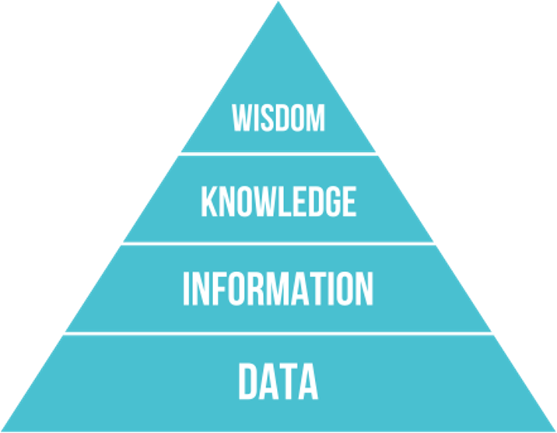
The DIKW Pyramid
Data to be synthesized into knowledge
Knowledge, in turn, can drive decision making

Slide 8
Data Science Background
Notes:
Without further ado, let’s dive in!!
Getting Started with RStudio.

Slide 9
What is data science?
Interdisciplinary field that uses computational methods, statistics, and broad analysis techniques (including visualization) to extract knowledge from data
Draws on a variety of academic disciplines, including mathematics, statistics, computer science, and information science/informatics
Critical to integrate domain knowledge: laboratory medicine

Slide 10
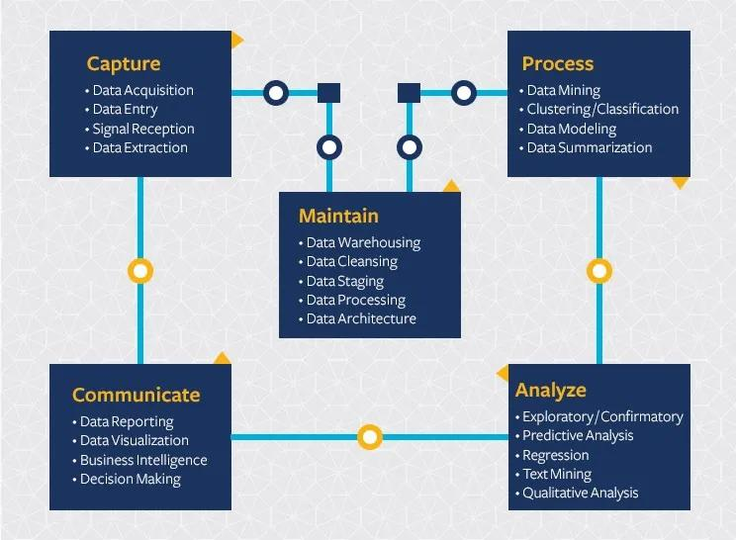
Computational tools support a broad lifecycle to manage a broad range of data
Data science extends beyond analysis of data and includes considerations for capturing and maintaining data
https://ischoolonline.berkeley.edu/data-science/what-is-data-science/

Slide 11
Statistics helps us interpret data based on expectations
Many categories of numeric lab data can be described by known distributions, e.g. normal distribution
Statistical methods allow us to evaluate hypotheses about the data
  Does the data fit a normal distribution? If not, why not?
  Are the differences between these sets of observations significant?
Notes:
Statistics can also be applied to non-numeric data
E.g. analysis of how words are used in clinical notes and deriving methods to extract useful info

Slide 12
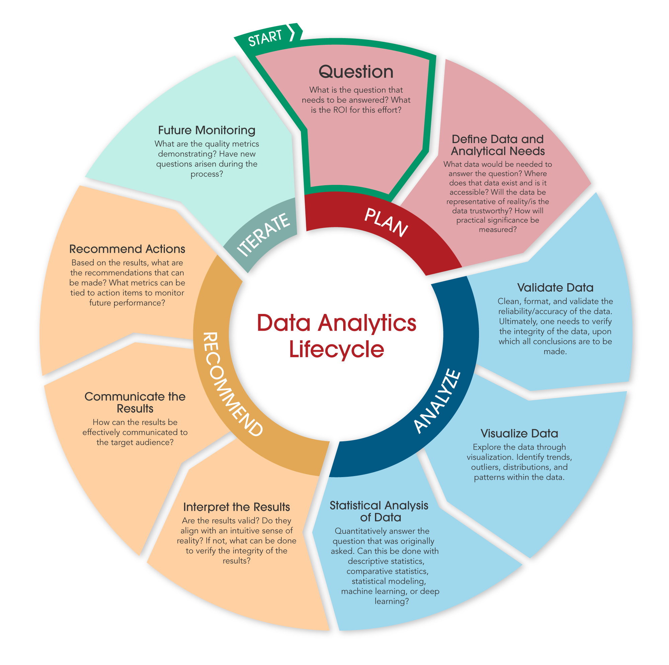
Data Analytics IS a SUBSET of Data Science
Data analytics includes discovering useful information and conclusions to support decision making from data
Using real-world data
Visualization
Statistical and exploratory analysis
Machine learning
Communicating results

Slide 13
Data Science Can be Categorized By How the Data is Applied
Descriptive
Diagnostic
Predictive
Prescriptive
What is happening?
Right now
Recent past
Why is it happening?
What are the root causes?
What will happen?
When might it happen?
What should we do?
Integrate what we think will happen with what has happened

Slide 14
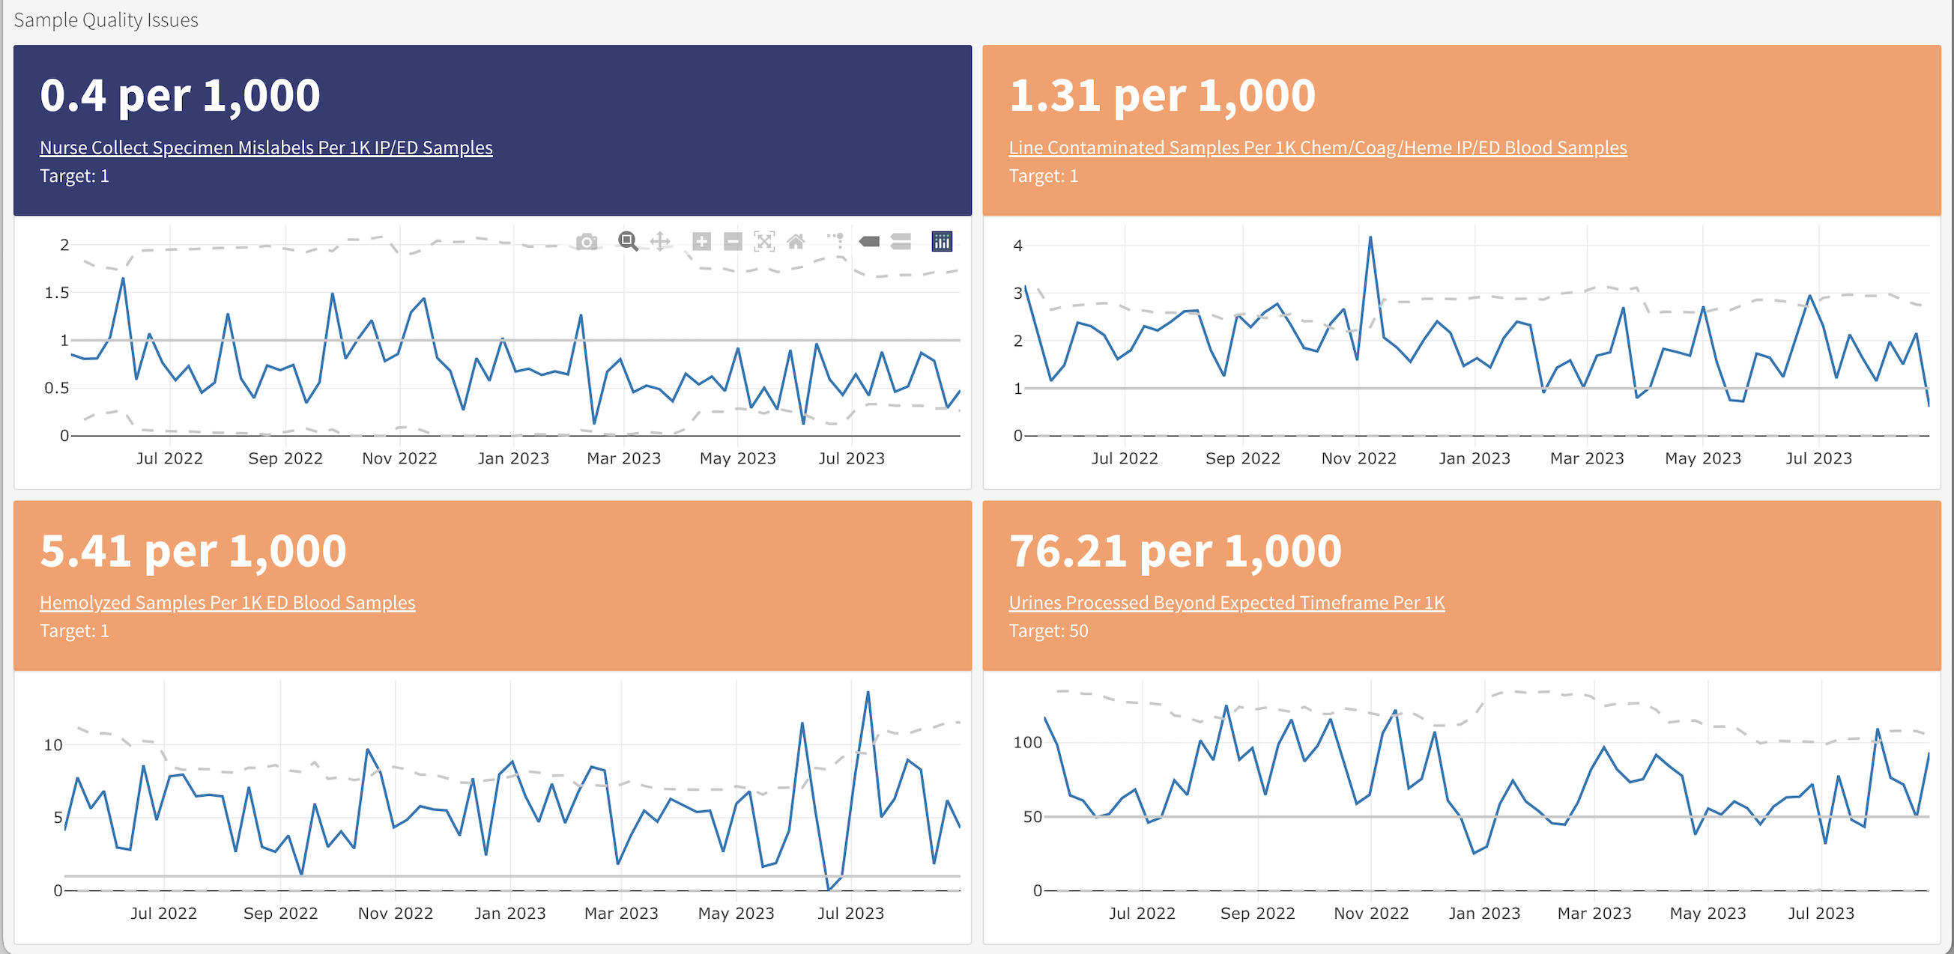
Descriptive Analytics Are Becoming More Common Across Healthcare Settings
DLMP Quality Assurance Dashboard

Slide 15
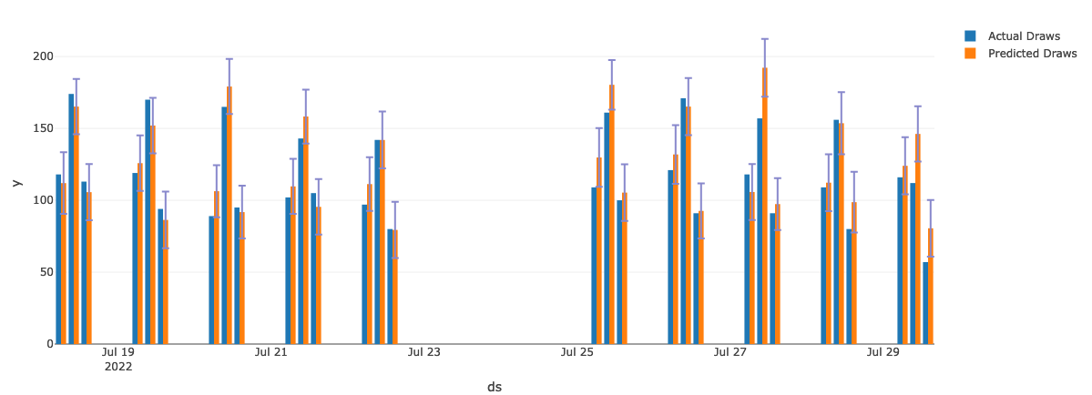
Predictive Analytics Are Emerging In Multiple Domains
UWMC Phlebotomy Prediction

Slide 16
What is the Role of the Laboratorian?
Define the important problems to solve and/or questions to answer
Subject matter expert: those generating the data best understand the data
Perform and interpret routine analyses (e.g. quality control)
Support the validation of analyses done by others
Develop and/or perform new analyses for quality improvement

Slide 17
Where Does Our Data Come From?
Notes:
So now that you've met us let's discuss for a moment how this workshop is going to work

Slide 18

Data in informatics
What is the purpose of data?
  Understanding and correct action
Informatics is the study of data
  Creation, management, and effective use
Foundational concepts related to data:
  Data representation
  Data quality
  Data flow in an organization from creation to use
© 2023 James H. Harrison, Jr.
Notes:
Informatics can be considered the study of data creation, management, and use in a domain

Slide 19
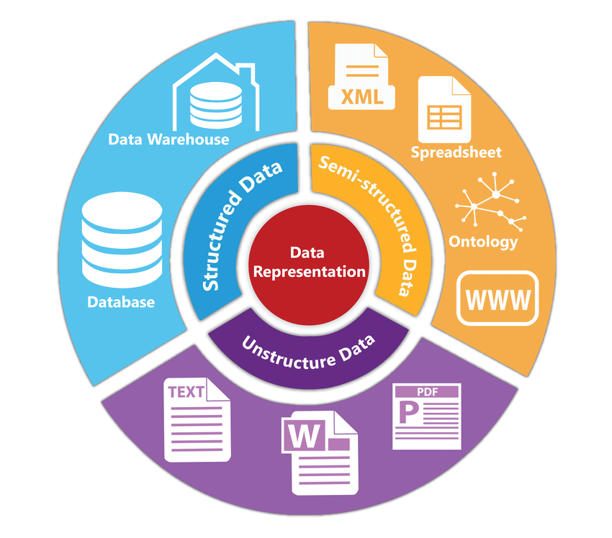
Data representation
Assignment of meaning to physical artifacts
  Characters, numbers, words, phrases
  Electronic states of computer memory
Human language: Unstructured data
  Extremely flexible
  Form and usage varies with location and time
  Context-dependent
Structured data
  Constrained language
  Well-defined syntax and semantics
Data standard: Formal agreement on data representation
Siriyasatien et al. IEEE Access 2018.
doi:10.1109/ACCESS.2018.2871241
© 2023 James H. Harrison, Jr.
Notes:
Pre-computer we usually meant visual artifacts
Data standards allow data sharing and interoperability

Slide 20
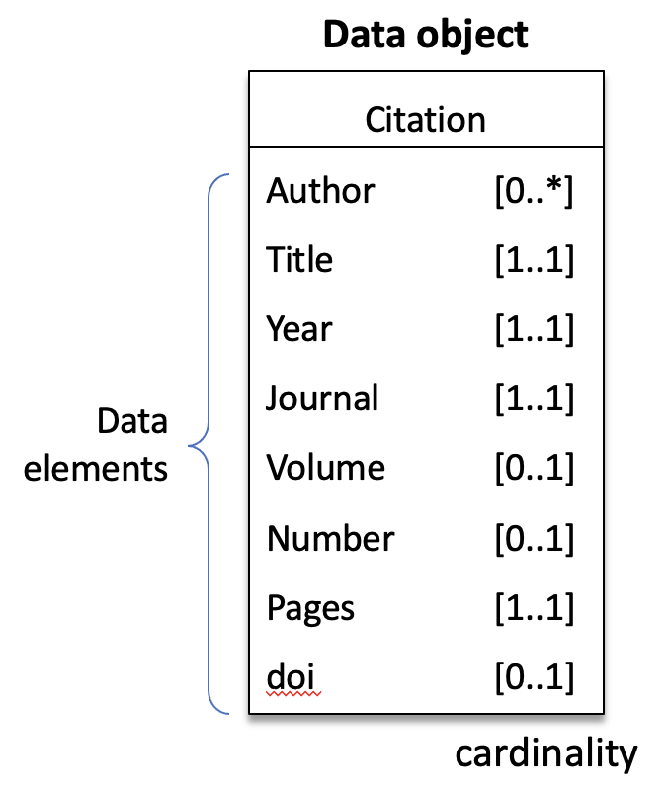
Structured data
Simple data types
  Numbers, characters,
  & character sequences (words, phrases, or codes)
Complex data types
  Represent concepts or physical things
  in the real world
  Often called “objects” or “entities”
  Built of constituent data types referred to
  as “data elements” or attributes
Interoperability of data
  Portability of data across information systems
  Requires common syntax and semantics,
  or data conversion
© 2023 James H. Harrison, Jr.
Notes:
Data objects have a name and then one or more attributes composed of name-value pairs (the name may be implicit) with the value being a simple or complex data type.

Slide 21
Simple (primitive) data types
Boolean
  Two values: pos/neg, T/F, Y/N, 1/0; 1 bit
Integers
  Whole numbers, ± ~10 quintillion; 64 bits (8 bytes)
Floating point numbers
  Decimal, 15 significant figures; inexact for 1/3, pi, etc.; 64 bits (8 bytes)
Characters
  ASCII or Unicode encoded; upper and lower case, numerals, symbols, non-printing characters; represented by numbers using 1 or 2 bytes
Character strings
  Sequences of characters with a variable number of bytes based on length
© 2023 James H. Harrison, Jr.

Slide 22
How many ways can “100” be represented in a computer?
Poll

Slide 23
Representation has functional implications
How many ways can “100” be represented in a computer?
  All representations are binary
  Integer (can’t divide with decimal result or include in text)
  Floating point (inexact, can’t include in text)
  Character string (can’t do math without conversion)
Medical systems often represent numbers as text.
  Space saving with usual sized numbers (less space to store a few chars)
  Display as characters is often primary purpose
    Math not often needed and can convert when necessary
© 2023 James H. Harrison, Jr.

Slide 24
Beyond Primitive Data Types
Quantitative – data that can be expressed numerically
  Continuous – can take any value within a range
    Example: 6.022, 3.14, 2.718
  Discrete – can only take specific values
    Example: 42
Qualitative – descriptive data that represents categories or characteristics
  Nominal – categories without a natural order
    Example: A, B, O
  Ordinal – categories with a natural order
    Example: Associates, Bachelors, Masters, Doctorate

Slide 25
We report urinalysis results as 1+, 2+, etc.
Which data type are these results?
Poll

Slide 26
Dates and Times Are Important Complex Data Types
Know and love the ISO 8601 standard for representing dates and times
Prevents ambiguity when interpreting and parsing
Dates in filenames sort chronologically
Excel unfortunately does not encourage the use of this format (but can parse it with some extra work)
Obligatory xkcd (https://xkcd.com/1179/)

Slide 27
Vectors & Matrices
Vector = one dimensional collection of homogeneous elements (i.e. everything is the same data type)
  Computer keeps track of the order
  May perform operations on entire vector or individual elements
  [1, 3, 5, 7, 9, 11, 13]
Note: some programming languages refer to the first position as 1 and others refer to it as 0
First position
Seventh position

Slide 28
Vectors & Matrices
Matrix = two dimensional collection of homogeneous data
Row 1, Column 1
1 | 2 | 3 | 4
5 | 6 | 7 | 8
9 | 10 | 11 | 12

Slide 29
Data Frames
Data frame = two-dimensional collection of heterogeneous data
  Spreadsheet-like data – typically organized in columns with a fixed data type
  Columns (or variables) often explicitly named
Identifier | Location | Test | Value
F123456 | Inpatient | Sodium | 140
W987654 | Outpatient | Potassium | 4.8
X234537 | ED | AST | 70

Slide 30
How do computers store data?
Data in working memory is volatile
  Lost if powered down
Non-volatile media (disks, tape, solid state storage, optical)
  Maintains state without power
Data can be preserved by copying it to non-volatile media in files
  Files are a block of binary data with a known size and position in the media
  Files have names, creation dates, and modification dates
  Filename extensions may indicate the type of file or creating program
  Internal structure allows data to be accurately recognized
    File structure may be proprietary or an open standard
© 2023 James H. Harrison, Jr.

Slide 31
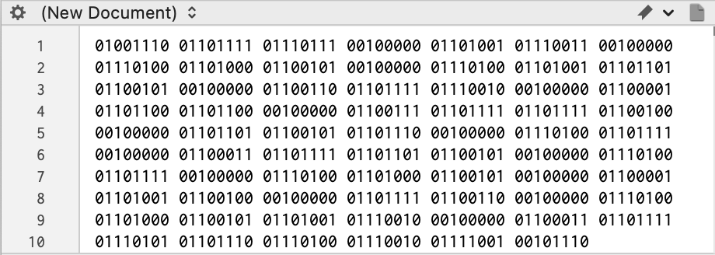
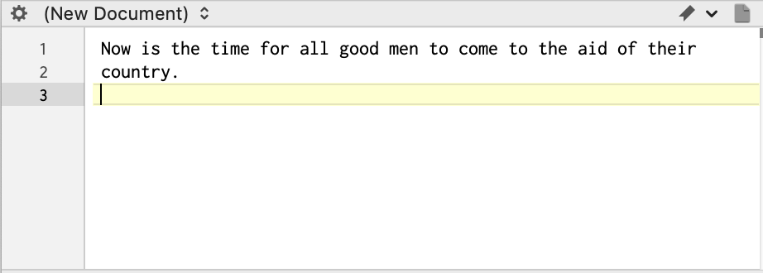
Storing data in files
Binary files
  Binary encoding, meaning is software-specific and defined by the software authors
  Native Word, Powerpoint, and Excel files
Text files
  Store data as characters, including numbers
  Plain text (“flat file” or unstructured text,
  a character string in Unicode or ASCII)
  Rich text format (RTF), character sequences
  indicate formatting
  Delimited files
    Comma separated values (CSV), quoted CSV,
    tab delimited, space delimited
  Structured text (eg, json or xml)
Databases
  Files specially structured for rapid and reliable data storage, update, search, and retrieval
ASCII-encoded text
© 2023 James H. Harrison, Jr.

Slide 32
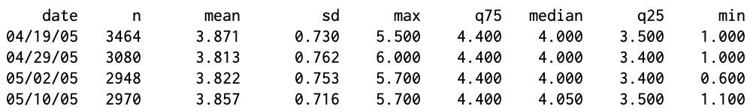
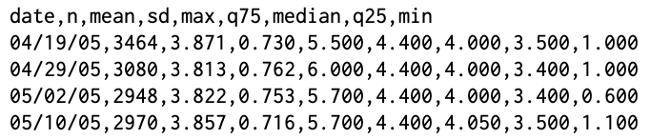
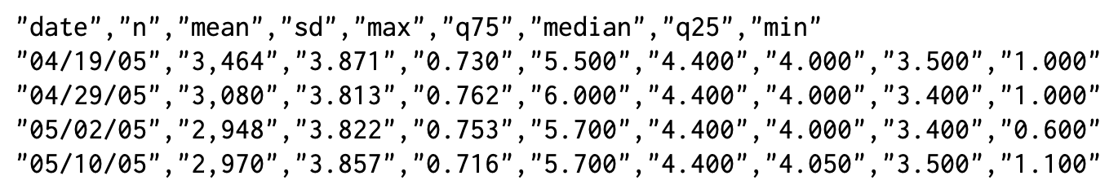
Delimited files
Comma separated values (CSV)
Quoted CSV
© 2023 James H. Harrison, Jr.

Slide 33
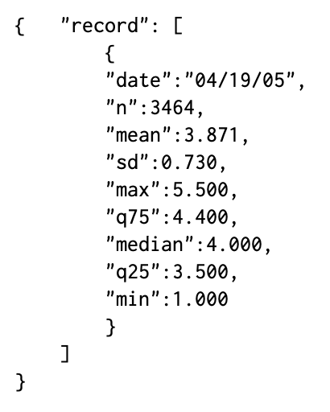
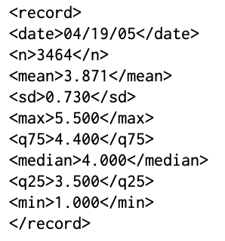
Structured text
Javascript Object Notation (JSON)
Extensible Markup Language (XML)
Tags “contain” values
Opening and closing tags
Nested tags
Larger files but
most flexible
Attribute-value pairs
Requires attribute
names for all values
© 2023 James H. Harrison, Jr.
Notes:
The CSV file is maintained at the top for comparison. A data standard defines the structure of complex data elements in a domain, including the delimiting scheme, names or codes for the attributes (data elements) with definitions, and standard constraints for attribute content with definitions of content meaning.

Slide 34
Before We Start: Orienting in RStudio
This module has no R code — but we'll still work inside RStudio.
Start with RStudio as simply a text editor: a place to open files, read them carefully, and record your answers.
In the Files pane, open exercises/module_1_exercises.qmd
This file opens in the Source pane — you'll type your answers directly into it
Save often (Cmd/Ctrl+S) — nothing here runs or executes

Slide 35
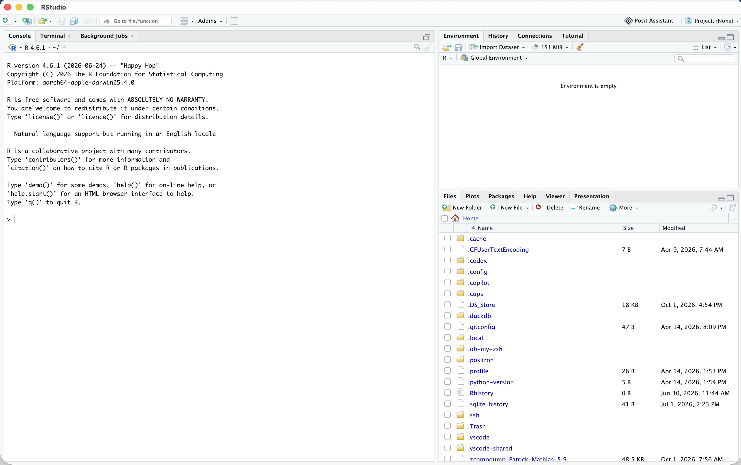
ENVIRONMENT
CONSOLE
FILES

Slide 36
1. Find unzipped course folder
2. Navigate to “exercises” folder
3. Click on “Module 1 Exercises.qmd” to open

Slide 37
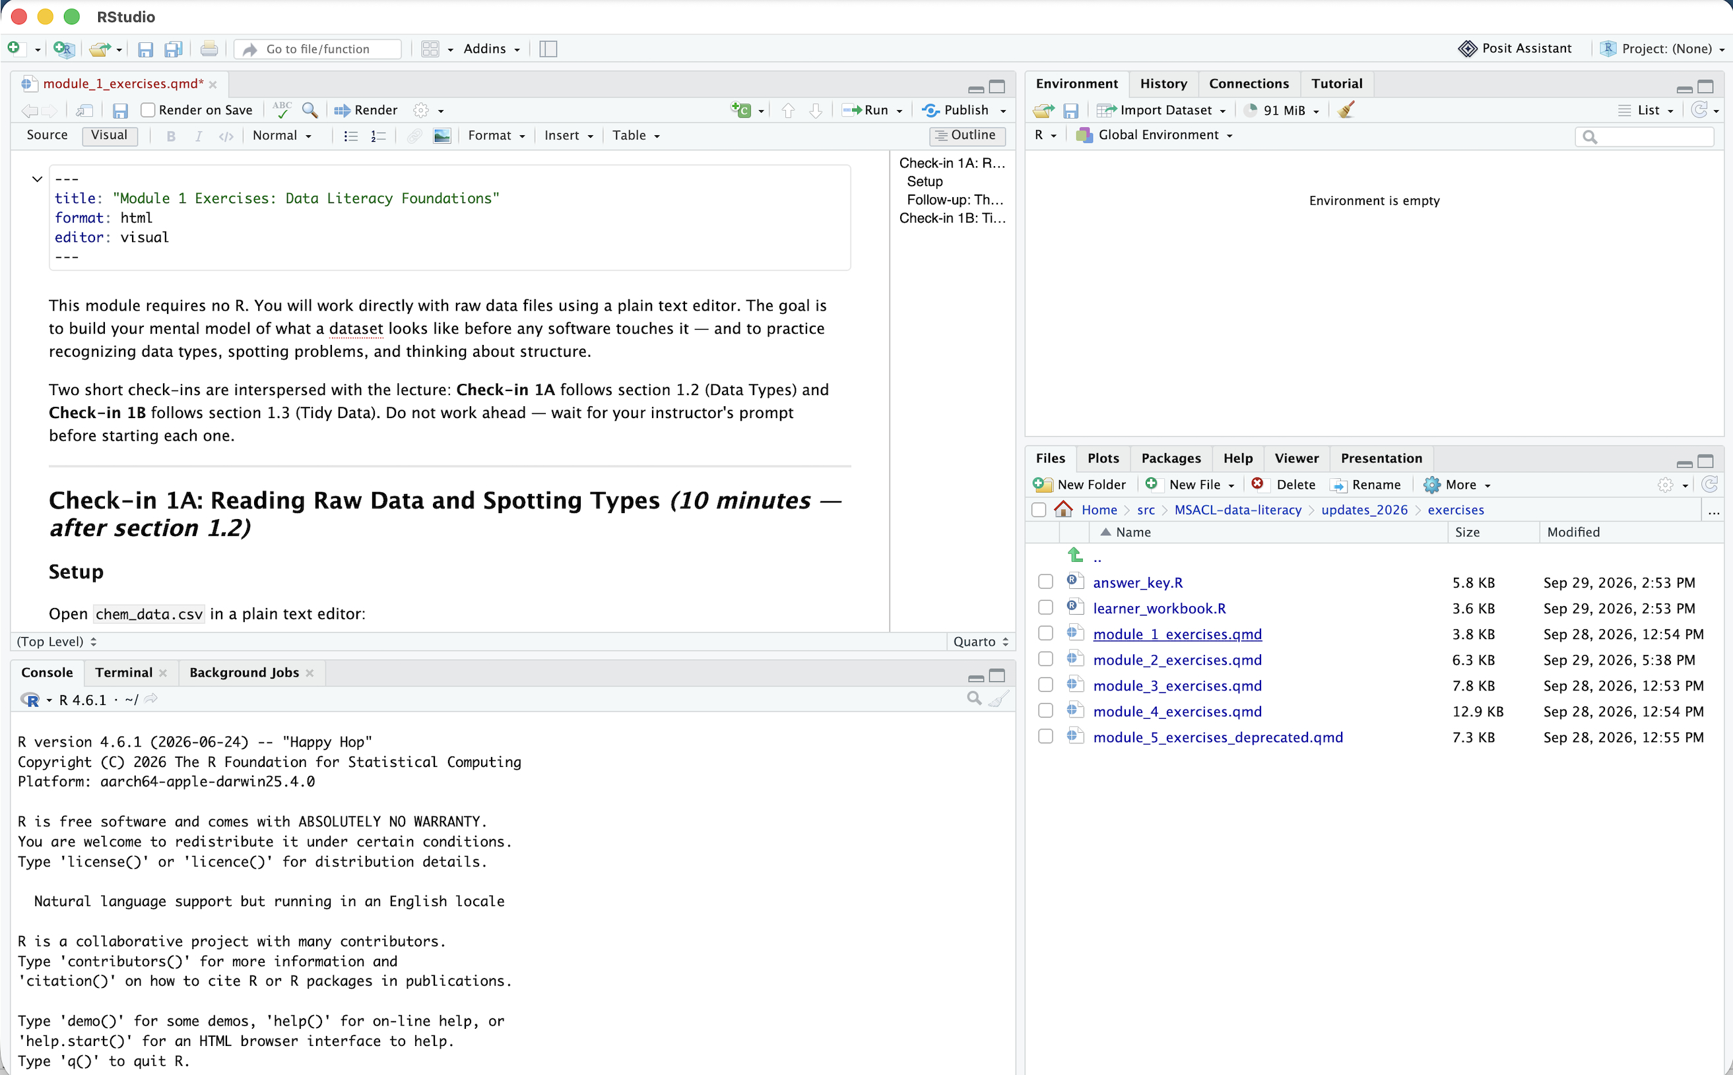
The source pane functions as file editor
ENVIRONMENT
SOURCE
CONSOLE
FILES

Slide 38
Spot the Data Types
Exercise
Navigate to and open chem_data.csv in a plain text editor (not RStudio — a real text editor).
For each of the 13 columns, predict the data type and flag any concerns.
Which columns look numeric vs. categorical? Where might censored or missing values be hiding? Which column will need an explicit datetime format?
Return to module_1_exercises.qmd in RStudio to record your answers.

Slide 39
Principles of TIDY Data
Notes:
So now that you've met us let's discuss for a moment how this workshop is going to work

Slide 40
Databases: Data storage plus
A file or files of related data elements structured for rapid and reliable data storage update, search, and retrieval
Database management system (DBMS)
  Collection of programs that allows multiple users to create, maintain, and use databases
  Controls user access to the data
  Indexes and sorts data to allow rapid numerical and text query
  May provide error checking and other data integrity features
  May allow databases that are larger than RAM
© 2023 James H. Harrison, Jr.

Slide 41

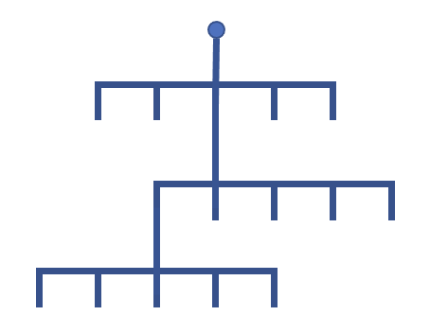
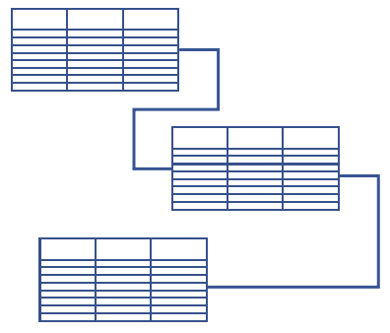
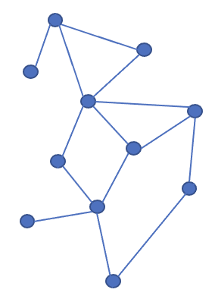
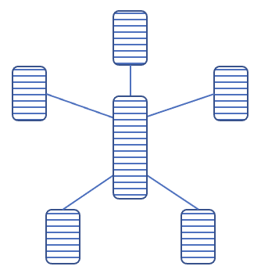
Types of databases (by data organization)
Flat file
  Simple: single table, rows (records) and columns (fields)
  Rigid structure, redundant data, slow with large data volume
Hierarchical
Relational
Other
Analytic databases
© 2023 James H. Harrison, Jr.

Slide 42


Why have different kinds of databases?
Represent relationships in data; avoid wasted space and redundancy
1 to 1
1 to many
many to many
Patient
Patient
Patients
PCP
Test results
Physicians
Flat file
Hierarchical
Relational
Flat file
Hierarchical
Relational
Flat file
Hierarchical
Relational
© 2023 James H. Harrison, Jr.
Notes:
Optional slide, for more detail

Slide 43
RDB keys, relations, and cardinality
PK
PK
Shared keys define links between tables (relations)
  Primary key (PK)
  Foreign key (FK)
  Matching on shared data
Cardinality
  1 to many (*)
  Many to 1
  Many to many
  1 to 1 (not shown)
  Optionality (0..)
PATIENT
PHYSICIANS
Pat_ID MRN Name…
Phys_ID Name Specialty…
•
•
•
•
•
•
1
1
PK
FK
FK
ENCOUNTERS
Enc_ID Date Pat_ID Phys_ID…
•
•
•
0..*
0..*
© 2023 James H. Harrison, Jr.
Notes:
Optional slide for more detail
Many to many reduces redundancy (takes care of repeated physicians from pure hierarchicial DB)
Importance of data integrity and not orphaning data
May delete to save time.

Slide 44
Relational databases May Utilize a “Tidy” Representation of Data
Patient ID | MRN | First Name | Last Name | Order ID | Order Code | Order Name | Accession | Tube
23 | 123456 | John | Smith | 101 | CBC | Complete Blood Count | 5679 | LAV
23 | 123456 | John | Smith | 102 | BMP | Basic Metabolic Panel | 5680 | GRN
24 | 098765 | Jane | Doe | 103 | BLDCLT | Blood Culture | 5733 | BLD
24 | 098765 | Jane | Doe | 104 | HPTSWKUP | Hepatitis Workup | 5734 | GLD
24 | 098765 | Jane | Doe | 104 | HPTSWKUP | Hepatitis Workup | 5735 | PRL
24 | 098765 | Jane | Doe | 105 | CRP | C Reactive Protein | 5812 | GRN
PatientID | MRN | FirstName | LastName
23 | 123456 | John | Smith
24 | 098765 | Jane | Doe
PatientID | OrderID | OrderCode | OrderName
23 | 101 | CBC | Complete Blood Count
23 | 102 | BMP | Basic Metabolic Panel
24 | 103 | BLDCLT | Blood Culture
24 | 104 | HPTSWKUP | Hepatitis Workup
24 | 105 | CRP | C Reactive Protein
OrderID | Accession | Tube
101 | 5679 | LAV
102 | 5680 | GRN
103 | 5733 | BLD
104 | 5734 | GLD
104 | 5735 | PRL
105 | 5812 | GRN
Notes:
One challenge in dealing with common extraction tools regardless of the system is the need to pull additional data – whether that is a larger data set than your utility can handle or a larger number of data elements than is available
It is important to recognize the value of speaking a relational database’s language and the flexibility that affords for extracting data
As a concrete example you may want to analyze some data that combined patient demographics, order details, and tube type
Each of these data elements may be stored in its own table within a database and based on your knowledge of the system and workflows you can connect the right data elements using a series of keys that establish the relationships between tables

Slide 45
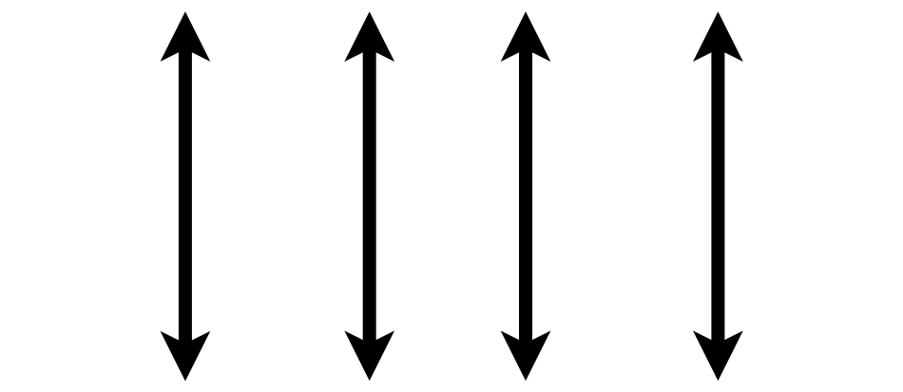

Tidy Data Summarized
A data set is tidy if:
Each variable is in its own column
Each observation is in its own row
Each value is in its own cell
MRN
Wickham, H. . (2014). Tidy Data. Journal of Statistical Software, 59(10), 1–23.

Slide 46
Consider a single data set with 4 variables
  country
  year
  population
  cases
  Public health data set intended to represent the cases of a disease in a population by country and year

Slide 47
Representation 1
## # A tibble: 12 x 4
## country year type count
## <chr> <int> <chr> <int>
## 1 Afghanistan 1999 cases 745
## 2 Afghanistan 1999 population 19987071
## 3 Afghanistan 2000 cases 2666
## 4 Afghanistan 2000 population 20595360
## 5 Brazil 1999 cases 37737
## 6 Brazil 1999 population 172006362
## 7 Brazil 2000 cases 80488
## 8 Brazil 2000 population 174504898
## 9 China 1999 cases 212258
## 10 China 1999 population 1272915272
## 11 China 2000 cases 213766
## 12 China 2000 population 1280428583

Slide 48
Representation 2
## # A tibble: 6 x 3
## country year rate
## * <chr> <int> <chr>
## 1 Afghanistan 1999 745/19987071
## 2 Afghanistan 2000 2666/20595360
## 3 Brazil 1999 37737/172006362
## 4 Brazil 2000 80488/174504898
## 5 China 1999 212258/1272915272
## 6 China 2000 213766/1280428583

Slide 49
Representation 3 is Tidy
## # A tibble: 6 x 4
## country year cases population
## <chr> <int> <int> <int>
## 1 Afghanistan 1999 745 19987071
## 2 Afghanistan 2000 2666 20595360
## 3 Brazil 1999 37737 172006362
## 4 Brazil 2000 80488 174504898
## 5 China 1999 212258 1272915272
## 6 China 2000 213766 1280428583

Slide 50
Why keep things tidy?
Consistent mental model for data = common data manipulation becomes easier
Many tools in R (and Excel + other languages) make it very easy to do sophisticated analysis and visualization with tidy data
Databases that store data from clinical information systems often already represent data in a tidy form

Slide 51
Tidy Data Summarized
A data set is tidy if:
Each variable is in its own column
Each observation is in its own row
Each value is in its own cell
MRN
Wickham, H. . (2014). Tidy Data. Journal of Statistical Software, 59(10), 1–23.

Slide 52
Tidy or Not Tidy?
Exercise
Compare chem_data.csv (long) and chem_data_wide.csv (wide).
Answer three written questions in Module 1 Exercises.qmd:
Which tidy principle does the wide format bend?
When is each format easier to use?
What would you need to do to a wide file before analyzing it in R?

Slide 53
Tips for Generating Your Own Data

Slide 54
Building your own data set
Data analysis projects beyond a certain complexity require creating your own variables or data frames (tables/spreadsheets)
In addition to building tidy data sets, consider steps to make future analysis easier

Slide 55
Naming Variables
Use variable (column) names that are easy for someone not performing your analysis to understand
  “result_value” as opposed to “x”
  “collection_time” instead of “time”
Stick to naming that will make it easier for a computer to read the data
  Avoid spaces in names: “result_value” instead of “result value” (space has meaning in languages like R)
All lowercase (or uppercase) will be easier for you to type, even if it is not easier for the computer to parse

Slide 56
Respect Data Types When Creating Variables
Variable inspection and summarization is much easier (and less error prone) if known data types are used
run_id | value
1 | 5
2 | cancelled
3 | 11
4 | < 2
5 | 4
run_id | value | comment
1 | 5
2 |  | cancelled
3 | 11
4 |  | < 2
5 | 4

Slide 57
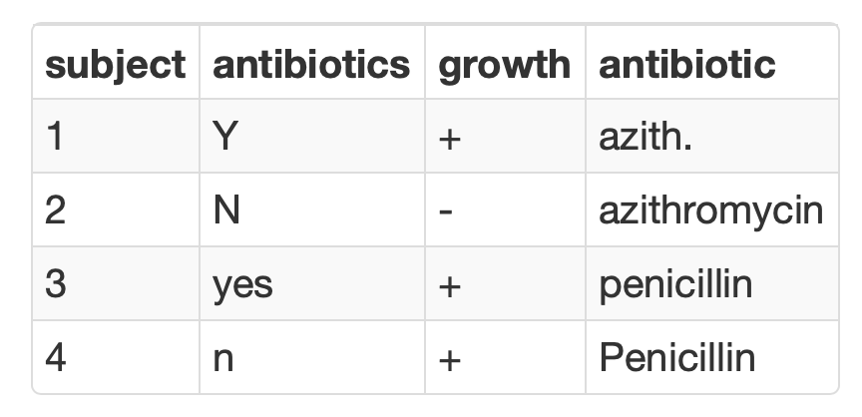
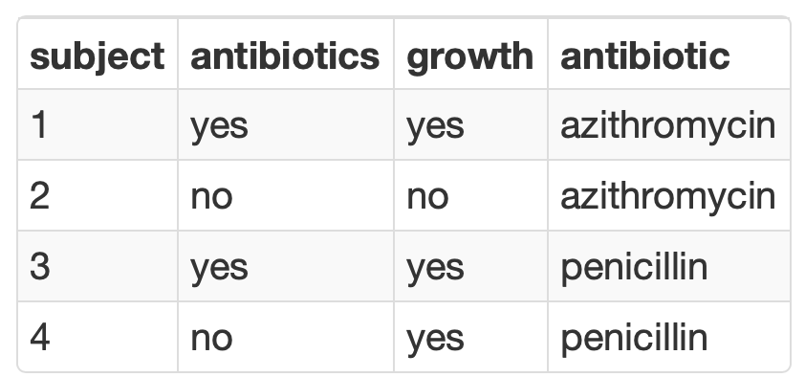
Consistency is Critical for Analyzing Categorical Variables
Summarization is seamless when consistent values are used to represent binary or categorical variables

Slide 58
Lesson Objectives
Describe the different types of analytics (i.e., descriptive, predictive, prescriptive)
Demonstrate how data science can augment expertise to draw robust conclusions and make better decisions
Compare and contrast different data types (e.g., numerical, categorical, timestamp, logical) used in data analytics
Illustrate best practices for organizing data in spreadsheet-based (rectangular) formats for use in data analytics
Identify common problems associated with real world laboratory data (e.g., censoring, keystroke errors, missing values, varied formats) and methods to mitigate them
Perform basic data cleaning and preparation steps to facilitate analysis
Notes:
In this first session our goal is to develop some familiarity with the R programming language.
We will also discuss the important role of reproducible data analysis and how R can help us with this.

Slide 59
References & Acknowledgements
James Harrison, Introduction to Pathology Informatics, Session 8: Cybersecurity, API Distribution 1.0, 2023. Available at: https://www.pathologyinformatics.org/teaching-slide-sets
Robert Benirschke & Chris McCudden for slides adapted from ADLM Data Science Certificate

